Slide 1
QA AUTOMATION PROCESS
FI MATS PROJECT

Slide 2
TOOLS
Notes:
These are the main tools that we are using in our daily automation testing.

Slide 3
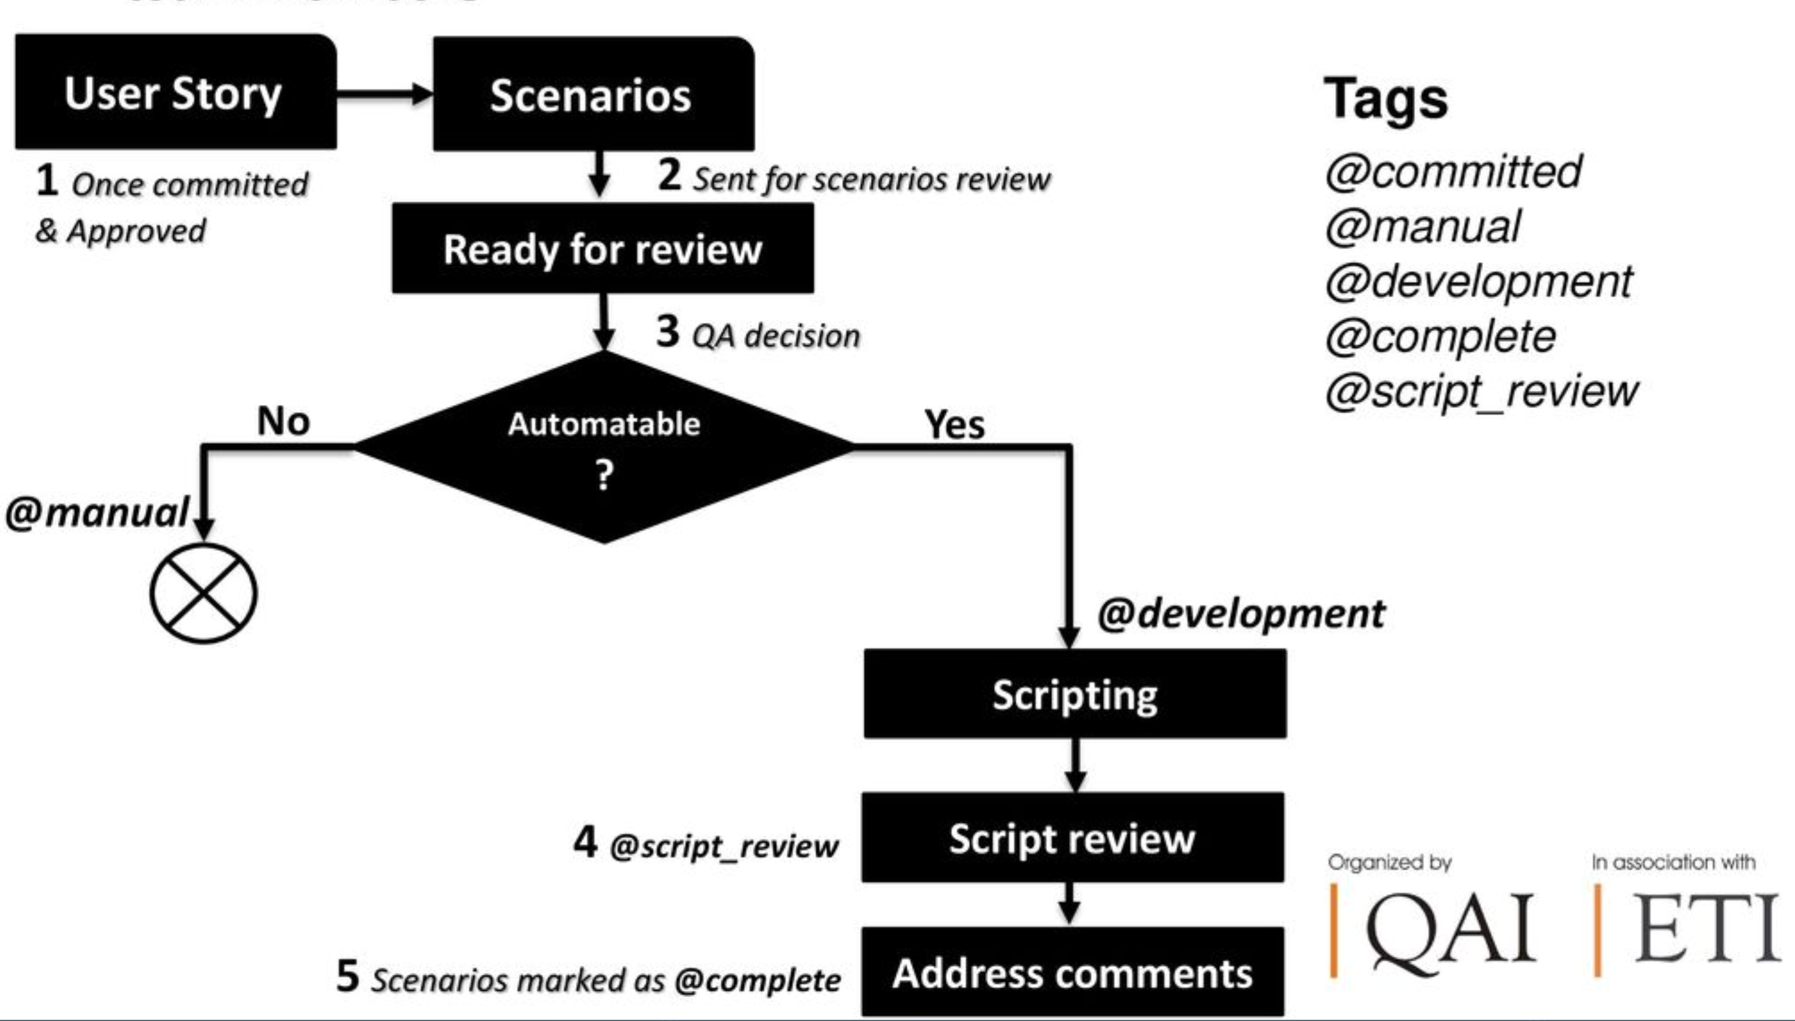
BDD Beginning
Notes:
BDD begins with a User Story ….

Slide 4
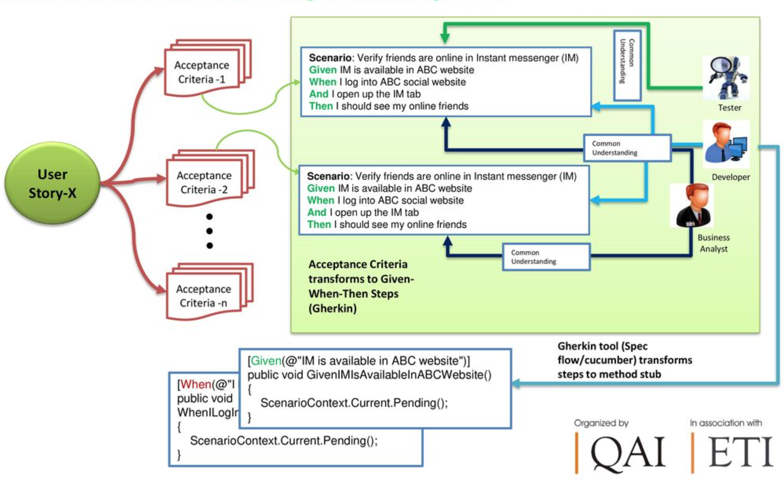
Test Automation In BDD Way

Slide 5
Gherkin syntax

Slide 6
Jenkins Deployment and Run

Slide 7
DEMO

